Slide 1
OS Introduction 6 Kernel Data Structures
David Liu
Fall 2021, Spring 2022

Slide 2
Learning Objectives
Discuss the role and importance of operating systems
Describe the general organization of a computer system and the role of interrupts
Describe the components in a modern, multiprocessor computer system
Illustrate the transition from user mode to kernel mode
Discuss how OS manages computing resources
Distinguish between protection and security
Describe common data structures for OS
Discuss how operating systems are used in various computing environments
Provide examples of free and open-source operating systems

Slide 3
Content
Key data structures for OS Kernel
Lists, Stacks, Queues
Trees
Hash Functions and Maps

Slide 4
Linear Storage
Array
Linked List
stack

Slide 5
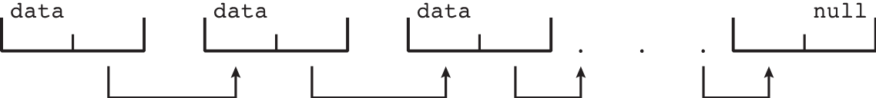
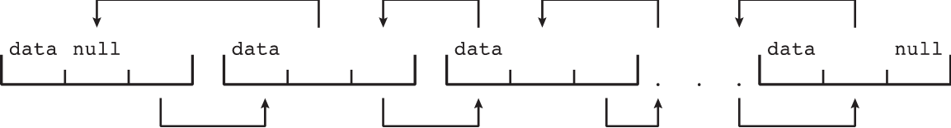
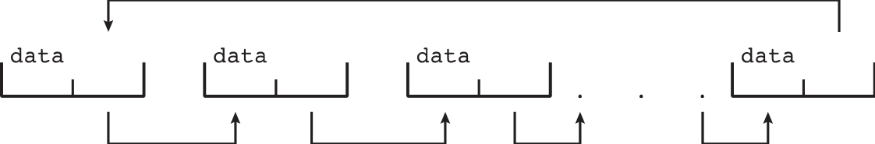
Linked Lists
Singly linked list
Doubly linked list
Circular linked list

Slide 6
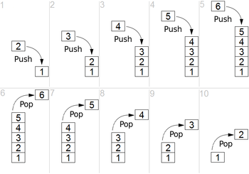
Stacks
LIFO for adding and removing items: push and pop
Function calls in OS

Slide 7
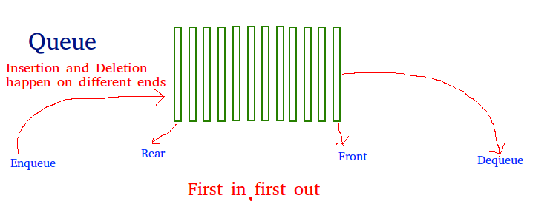
Queues
FIFO for adding and removing
Job queues in OS

Slide 8
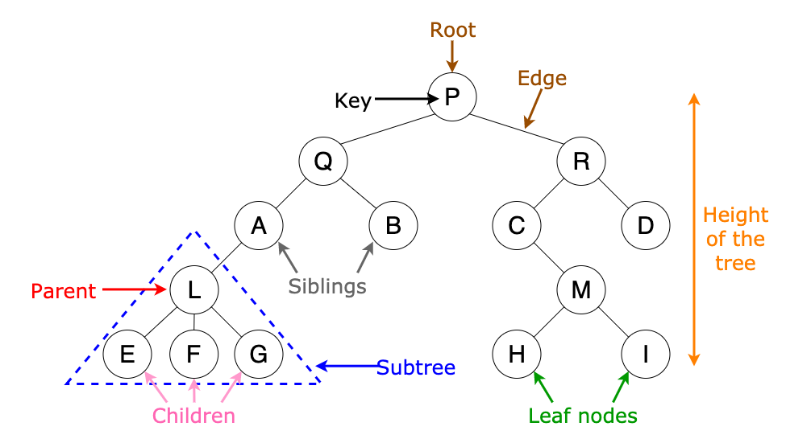
Trees

Slide 9
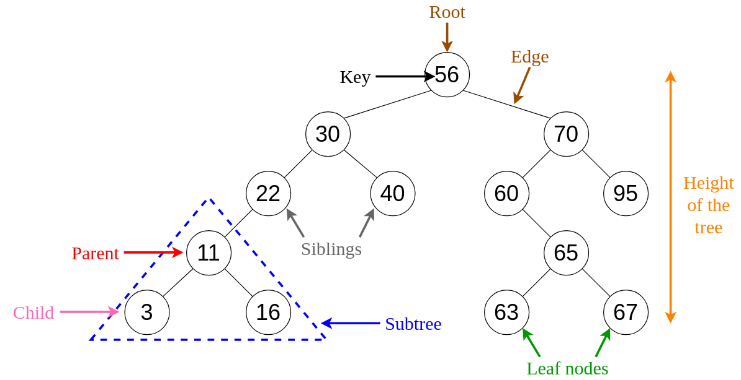
Binary Search Tree
Balanced binary search tree: 0(lg n) search time
CPU-scheduling in OS

Slide 10
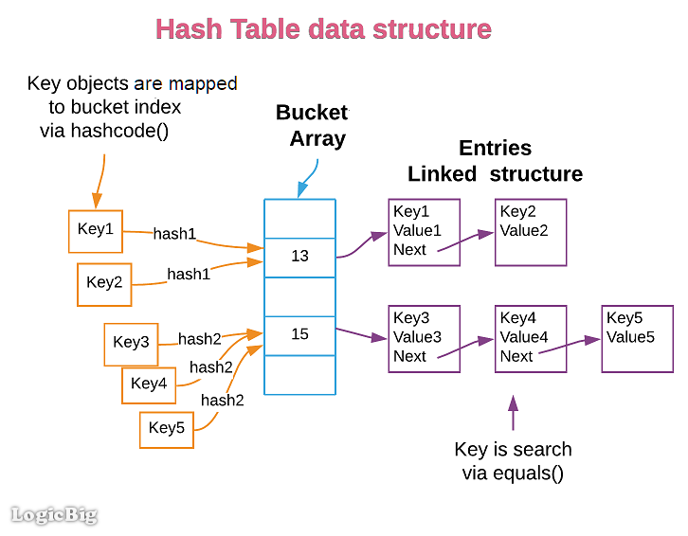
Hash functions and Maps
Indexing for quick access: O(1)

Slide 11
Bitmaps
Resources: available (not used): 0, unavailable: 1
0 | 1 | 1 | 1 | 1 | 1 | 1 | 1 | 1 | 1 | 0 | 0 | 0 | 0 | 1 | 1
16 bits for 16 resources

